Slide 1
5
Control Statements: Part 2

Slide 2
Not everything that can be counted counts, and not every thing that counts can be counted.
  Albert Einstein
Who can control his fate?
  William Shakespeare
The used key is always bright.
  Benjamin Franklin
Intelligence… is the faculty of making artificial objects, especially tools to make tools.
  Henri Bergson
Every advantage in the past is judged in the light of the final issue.
  Demosthenes

Slide 3
OBJECTIVES
In this chapter you’ll learn:
The essentials of counter-controlled repetition.
To use the for and do…while repetition statements to execute statements in a program repeatedly.
To understand multiple selection using the switch selection statement.
To use the break and continue program control statements to alter the flow of control.
To use the logical operators to form complex conditional expressions in control statements.
To avoid the consequences of confusing the equality and assignment operators.

Slide 4
5.1 Introduction
5.2 Essentials of Counter-Controlled Repetition
5.3 for Repetition Statement
5.4 Examples Using the for Statement
5.5 do…while Repetition Statement
5.6 switch Multiple-Selection Statement
5.7 break and continue Statements
5.8 Logical Operators
5.9 Confusing Equality (==) and Assignment (=) Operators
5.10 Structured Programming Summary
5.11 (Optional) Software Engineering Case Study: Identifying Objects’ States and Activities in the ATM System
5.12 Wrap-Up

Slide 5
5.1 Introduction
Continue structured programming discussion
  Introduce C++’s remaining control structures
    for, do…while, switch

Slide 6
5.2 Essentials of Counter-Controlled Repetition
Counter-controlled repetition requires:
  Name of a control variable (loop counter)
  Initial value of the control variable
  Loop-continuation condition that tests for the final value of the control variable
  Increment/decrement of control variable at each iteration

Slide 7
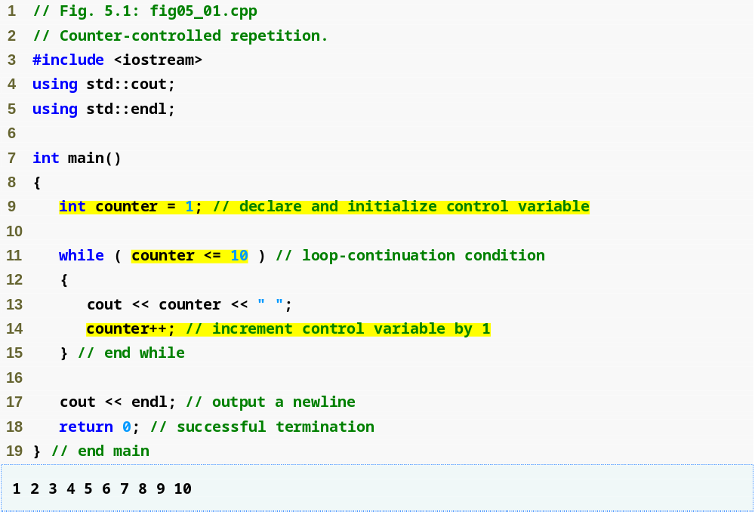
Outline
Control-variable name is counter with variable’s initial value set to 1
fig05_01.cpp
(1 of 1)
Condition tests for counter’s final value
Increment the value in counter

Slide 8
Common Programming Error 5.1
Floating-point values are approximate, so controlling counting loops with floating-point variables can result in imprecise counter values and inaccurate tests for termination.

Slide 9
Error-Prevention Tip 5.1
Control counting loops with integer values.

Slide 10
Good Programming Practice 5.1
Put a blank line before and after each control statement to make it stand out in the program.

Slide 11
Good Programming Practice 5.2
Too many levels of nesting can make a program difficult to understand. As a rule, try to avoid using more than three levels of indentation.

Slide 12
Good Programming Practice 5.3
Vertical spacing above and below control statements and indentation of the bodies of control statements within the control statement headers give programs a two-dimensional appearance that greatly improves readability.

Slide 13
5.3 for Repetition Statement
for repetition statement
  Specifies counter-controlled repetition details in a single line of code

Slide 14
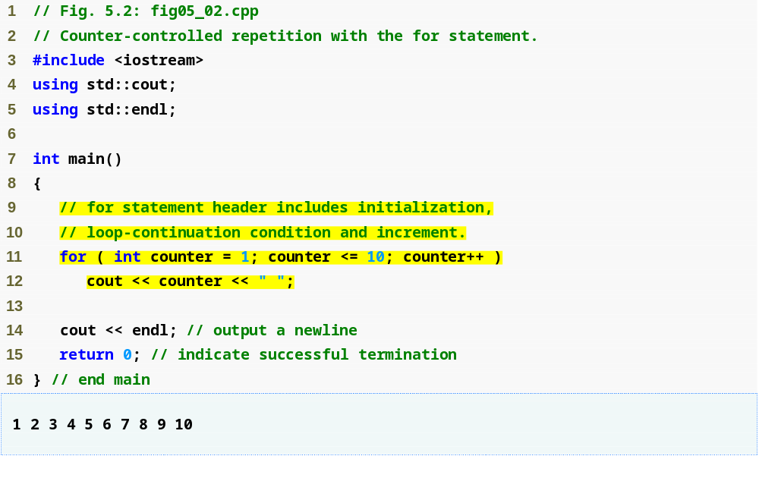
Outline
fig05_02.cpp
(1 of 1)
Increment for counter
Condition tests for counter’s final value
Control-variable name is counter with initial value 1

Slide 15
Common Programming Error 5.2
Using an incorrect relational operator or using an incorrect final value of a loop counter in the condition of a while or for statement can cause off-by-one errors.

Slide 16
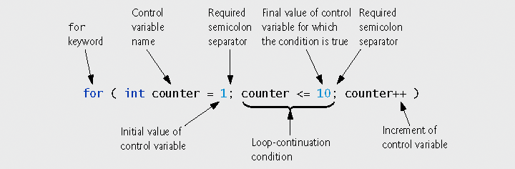
Fig. 5.3 | for statement header components.

Slide 17
Good Programming Practice 5.4
Using the final value in the condition of a while or for statement and using the <= relational operator will help avoid off-by-one errors. For a loop used to print the values 1 to 10, for example, the loop-continuation condition should be counter <= 10 rather than counter < 10 (which is an off-by-one error) or counter < 11 (which is nevertheless correct). Many programmers prefer so-called zero-based counting, in which, to count 10 times through the loop, counter would be initialized to zero and the loop-continuation test would be counter < 10.

Slide 18
5.3 for Repetition Statement (Cont.)
General form of the for statement
  for ( initialization; loopContinuationCondition; increment )
  statement;
Can usually be rewritten as:
  initialization;
  while ( loopContinuationCondition )
{
statement;
increment;
}
If the control variable is declared in the initialization expression
  It will be unknown outside the for statement

Slide 19
Common Programming Error 5.3
When the control variable of a for statement is declared in the initialization section of the for statement header, using the control variable after the body of the statement is a compilation error.

Slide 20
Portability Tip 5.1
In the C++ standard, the scope of the control variable declared in the initialization section of a for statement differs from the scope in older C++ compilers. In pre-standard compilers, the scope of the control variable does not terminate at the end of the block defining the body of the for statement; rather, the scope terminates at the end of the block that encloses the for statement. C++ code created with prestandard C++ compilers can break when compiled on standard-compliant compilers. If you are working with prestandard compilers and you want to be sure your code will work with standard-compliant compilers, there are two defensive programming strategies you can use: either declare control variables with different names in every for statement, or, if you prefer to use the same name for the control variable in several for statements, declare the control variable before the first for statement.

Slide 21
Good Programming Practice 5.5
Place only expressions involving the control variables in the initialization and increment sections of a for statement. Manipulations of other variables should appear either before the loop (if they should execute only once, like initialization statements) or in the loop body (if they should execute once per repetition, like incrementing or decrementing statements).

Slide 22
5.3 for Repetition Statement (Cont.)
The initialization and increment expressions can be comma-separated lists of expressions
  These commas are comma operators
    Comma operator has the lowest precedence of all operators
  Expressions are evaluated from left to right
  Value and type of entire list are value and type of the rightmost expressions

Slide 23
Common Programming Error 5.4
Using commas instead of the two required semicolons in a for header is a syntax error.

Slide 24
Common Programming Error 5.5
Placing a semicolon immediately to the right of the right parenthesis of a for header makes the body of that for statement an empty statement. This is usually a logic error.

Slide 25
Error-Prevention Tip 5.2
Although the value of the control variable can be changed in the body of a for statement, avoid doing so, because this practice can lead to subtle logic errors.

Slide 26
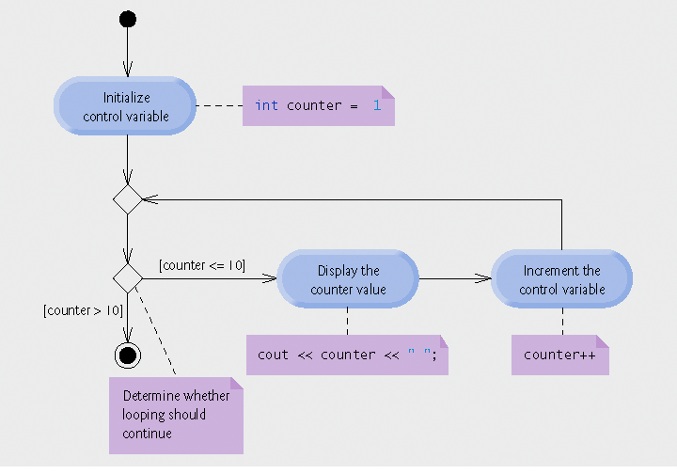
Fig. 5.4 | UML activity diagram for the for statement in Fig. 5.2.

Slide 27
5.4 Examples Using the for Statement
for statement examples
  Vary control variable from 1 to 100 in increments of 1
    for ( int i = 1; i <= 100; i++ )
  Vary control variable from 100 to 1 in increments of -1
    for ( int i = 100; i >= 1; i-- )
  Vary control variable from 7 to 77 in steps of 7
    for ( int i = 7; i <= 77; i += 7 )
  Vary control variable from 20 to 2 in steps of -2
    for ( int i = 20; i >= 2; i -= 2 )
  Vary control variable over the sequence: 2, 5, 8, 11, 14, 17, 20
    for ( int i = 2; i <= 20; i += 3 )
  Vary control variable over the sequence: 99, 88, 77, 66, 55, 44, 33, 22, 11, 0
    for ( int i = 99; i >= 0; i -= 11 )

Slide 28
Common Programming Error 5.6
Not using the proper relational operator in the loop-continuation condition of a loop that counts downward (such as incorrectly using i <= 1 instead of i >= 1 in a loop counting down to 1) is usually a logic error that yields incorrect results when the program runs.

Slide 29
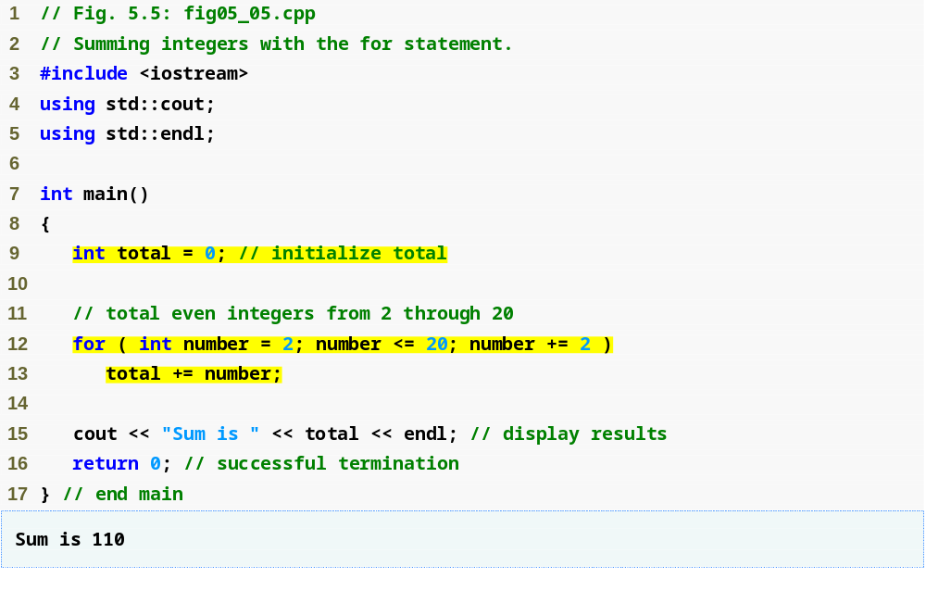
Outline
fig05_05.cpp
(1 of 1)
Vary number from 2 to 20 in steps of 2
Add the current value of number to total

Slide 30
5.4 Examples Using the for Statement (Cont.)
Using a comma-separated list of expressions
  Lines 12-13 of Fig. 5.5 can be rewritten as
  for ( int number = 2; // initialization
  number <= 20; // loop continuation condition
  total += number, number += 2 ) // total and
  // increment
  ; // empty statement

Slide 31
Good Programming Practice 5.6
Although statements preceding a for and statements in the body of a for often can be merged into the for header, doing so can make the program more difficult to read, maintain, modify and debug.

Slide 32
Good Programming Practice 5.7
Limit the size of control statement headers to a single line, if possible.

Slide 33
5.4 Examples Using the for Statement (Cont.)
Standard library function std::pow
  Performs exponentiation
  Example
    pow( x, y )
      Calculates the value of x raised to the y^{th} power
  Requires header file <cmath>

Slide 34
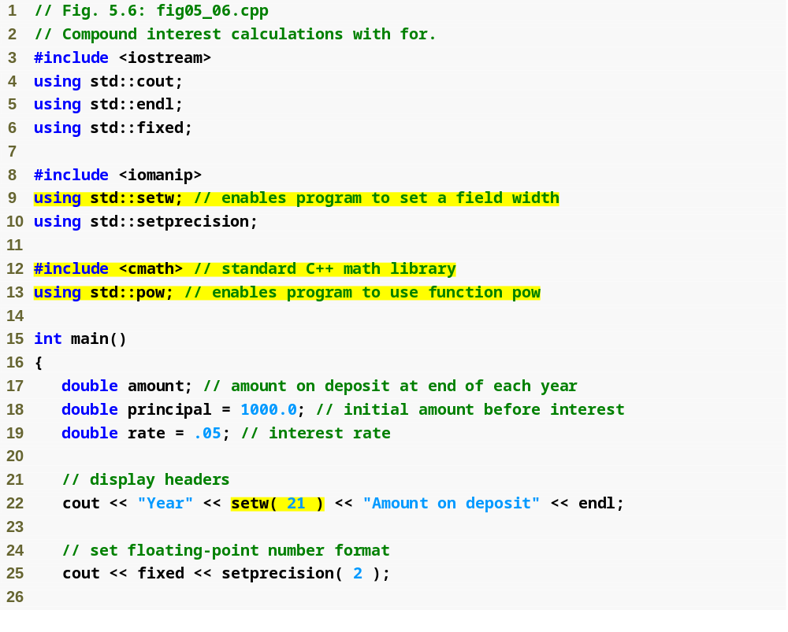
Outline
setw stream manipulator will set a field width
fig05_06.cpp
(1 of 2)
standard library function pow (in header file <cmath>)
C++ treats floating-point values as type double
Specify that the next value output should appear in a field width of 21

Slide 35
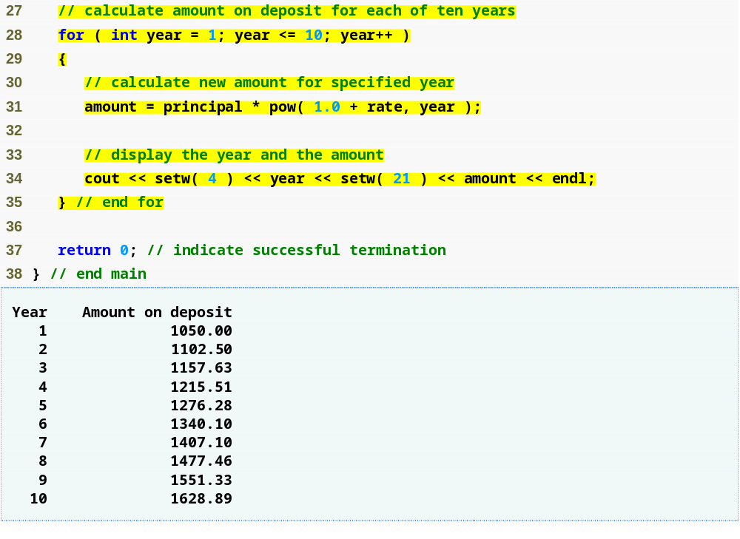
Outline
Calculate amount within for statement
fig05_06.cpp
(2 of 2)
Use the setw stream manipulator to set field width

Slide 36
Common Programming Error 5.7
In general, forgetting to include the appropriate header file when using standard library functions (e.g., <cmath> in a program that uses math library functions) is a compilation error.

Slide 37
Good Programming Practice 5.8
Do not use variables of type float or double to perform monetary calculations. The imprecision of floating-point numbers can cause errors that result in incorrect monetary values. In the Exercises, we explore the use of integers to perform monetary calculations. [Note: Some third-party vendors sell C++ class libraries that perform precise monetary calculations.]

Slide 38
5.4 Examples Using the for Statement (Cont.)
Formatting numeric output
  Stream manipulator setw
    Sets field width
      Right justified by default
        Stream manipulator left to left-justify
        Stream manipulator right to right-justify
    Applies only to the next output value
  Stream manipulators fixed and setprecision
    Sticky settings
      Remain in effect until they are changed

Slide 39
Performance Tip 5.1
Avoid placing expressions whose values do not change inside loops—but, even if you do, many of today’s sophisticated optimizing compilers will automatically place such expressions outside the loops in the generated machine-language code.

Slide 40
Performance Tip 5.2
Many compilers contain optimization features that improve the performance of the code you write, but it is still better to write good code from the start.

Slide 41
5.5 do…while Repetition Statement
do…while statement
  Similar to while statement
  Tests loop-continuation after performing body of loop
    Loop body always executes at least once

Slide 42
Good Programming Practice 5.9
Always including braces in a do...while statement helps eliminate ambiguity between the while statement and the do...while statement containing one statement.

Slide 43
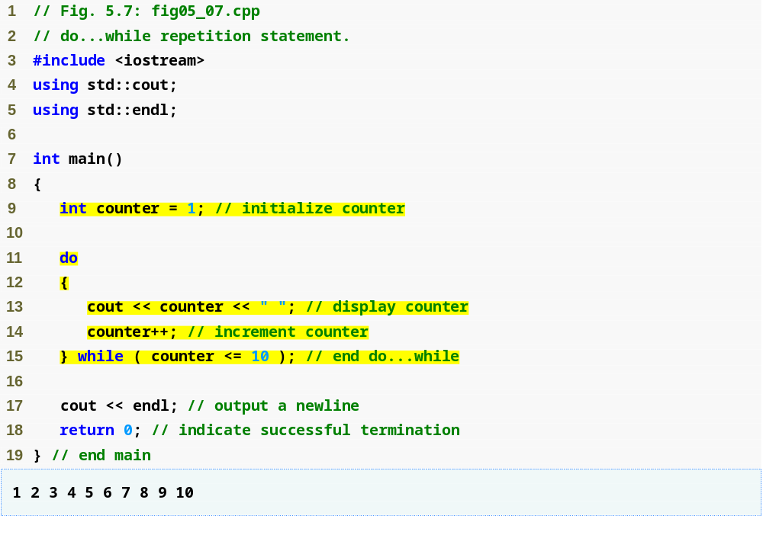
Outline
Declare and initialize control variable counter
fig05_07.cpp
(1 of 1)
do…while loop displays counter’s value before testing for counter’s final value

Slide 44
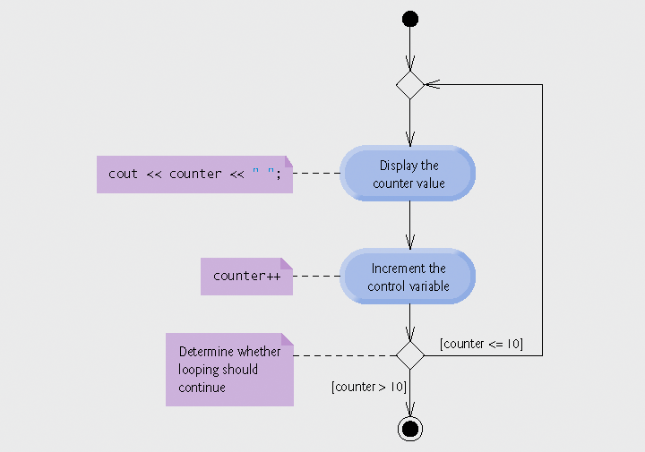
Fig. 5.8 | UML activity diagram for the do...while repetition statement of Fig. 5.7.

Slide 45
5.6 switch Multiple-Selection Statement
switch statement
  Used for multiple selections
  Tests a variable or expression
    Compared against constant integral expressions to decide on action to take
      Any combination of character constants and integer constants that evaluates to a constant integer value

Slide 46
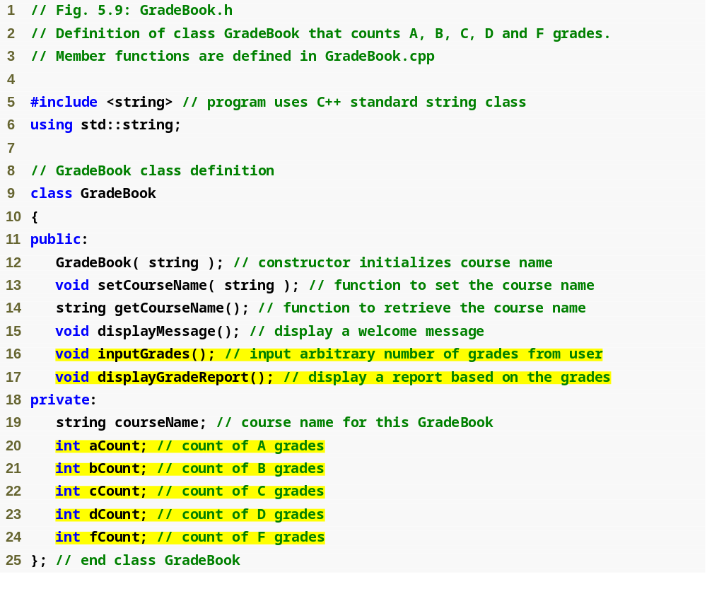
Outline
fig05_09.cpp
(1 of 1)
Counter variable for each grade category

Slide 47
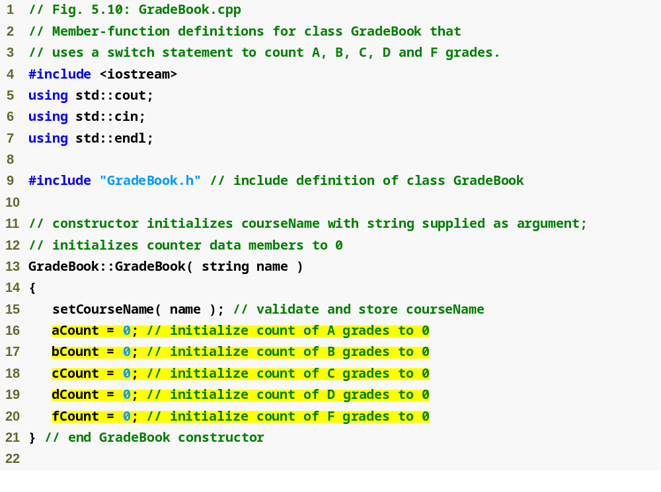
Outline
fig05_10.cpp
(1 of 5)
Initialize each counter variable to 0

Slide 48
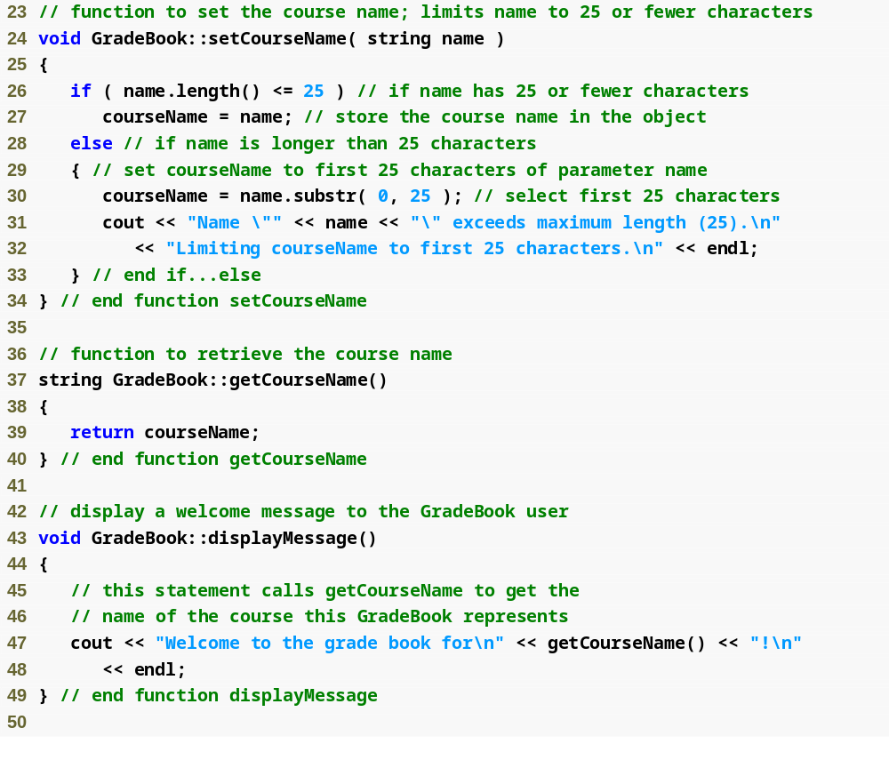
Outline
fig05_10.cpp
(2 of 5)

Slide 49
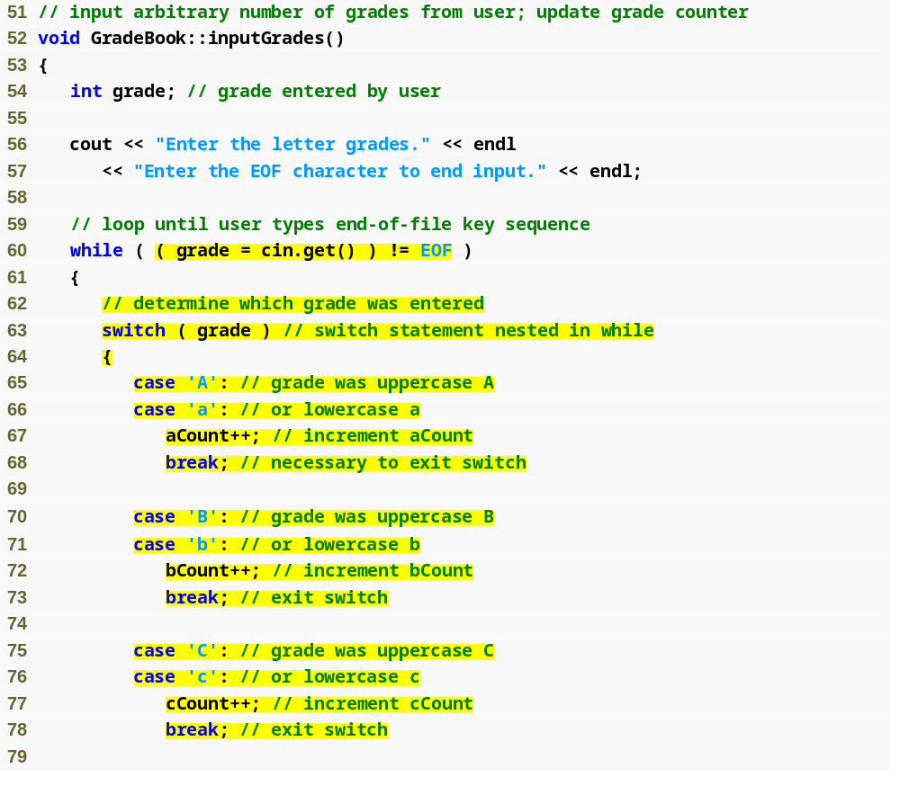
Outline
fig05_10.cpp
(3 of 5)
Loop condition uses function cin.get to determine whether there is more data to input
switch statement determines which case label to execute, depending on controlling expression
grade is the controlling expression
case labels for a grade of A
break statement transfers control to after the end of the switch statement

Slide 50
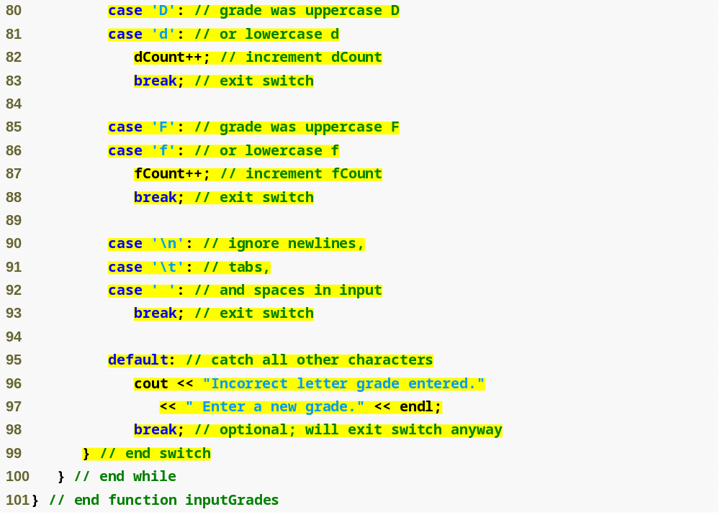
Outline
fig05_10.cpp
(4 of 5)
Ignore whitespace characters, do not display an error message
default case for an invalid letter grade

Slide 51
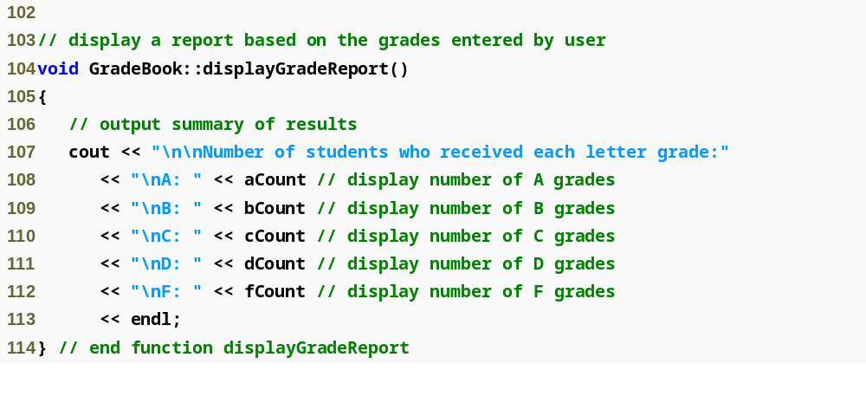
Outline
fig05_01.cpp
(5 of 5)

Slide 52
5.6 switch Multiple-Selection Statement (Cont.)
Reading character input
  Function cin.get()
    Reads one character from the keyboard
  Integer value of a character
    static_cast< int >( character )
  ASCII character set
    Table of characters and their decimal equivalents
  EOF
    <ctrl> d in UNIX/Linux
    <ctrl> z in Windows

Slide 53
Portability Tip 5.2
The keystroke combinations for entering end-of-file are system dependent.

Slide 54
Portability Tip 5.3
Testing for the symbolic constant EOF rather than –1 makes programs more portable. The ANSI/ISO C standard, from which C++ adopts the definition of EOF, states that EOF is a negative integral value (but not necessarily –1), so EOF could have different values on different systems.

Slide 55
5.6 switch Multiple-Selection Statement (Cont.)
switch statement
  Controlling expression
    Expression in parentheses after keyword switch
  case labels
    Compared with the controlling expression
    Statements following the matching case label are executed
      Braces are not necessary around multiple statements in a case label
      A break statements causes execution to proceed with the first statement after the switch
        Without a break statement, execution will fall through to the next case label

Slide 56
5.6 switch Multiple-Selection Statement (Cont.)
switch statement (Cont.)
  default case
    Executes if no matching case label is found
    Is optional
      If no match and no default case
        Control simply continues after the switch

Slide 57
Common Programming Error 5.8
Forgetting a break statement when one is needed in a switch statement is a logic error.

Slide 58
Common Programming Error 5.9
Omitting the space between the word case and the integral value being tested in a switch statement can cause a logic error. For example, writing case3: instead of writing case 3: simply creates an unused label. We will say more about this in Appendix E, C Legacy Code Topics. In this situation, the switch statement will not perform the appropriate actions when the switch’s controlling expression has a value of 3.

Slide 59
Good Programming Practice 5.10
Provide a default case in switch statements. Cases not explicitly tested in a switch statement without a default case are ignored. Including a default case focuses the programmer on the need to process exceptional conditions. There are situations in which no default processing is needed. Although the case clauses and the default case clause in a switch statement can occur in any order, it is common practice to place the default clause last.

Slide 60
Good Programming Practice 5.11
The last case in a switch statement does not require a break statement. Some programmers include this break for clarity and for symmetry with other cases.

Slide 61
Common Programming Error 5.10
Not processing newline and other white-space characters in the input when reading characters one at a time can cause logic errors.

Slide 62
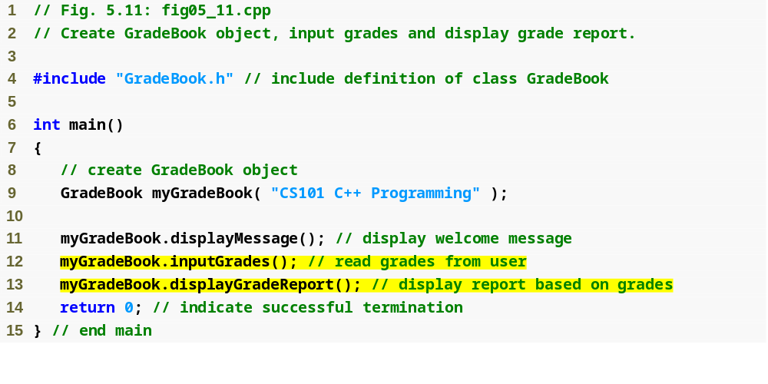
Outline
fig05_11.cpp
(1 of 2)

Slide 63
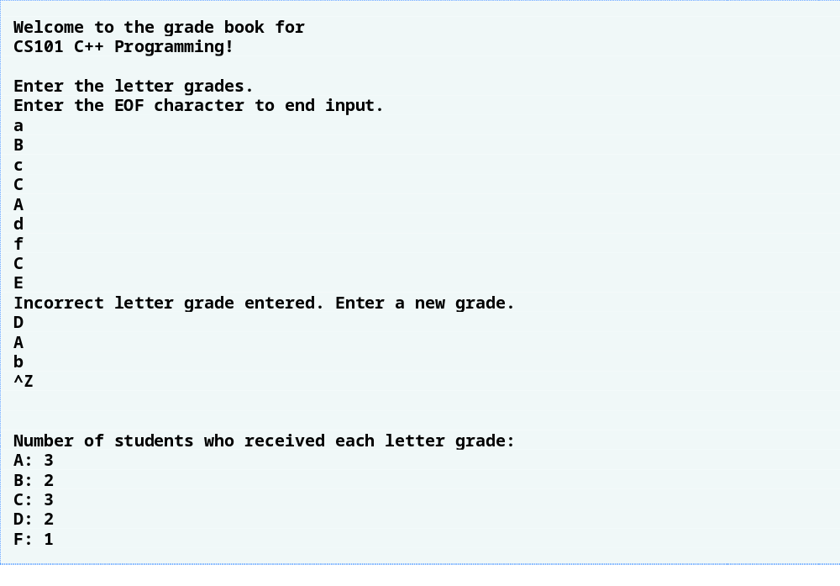
Outline
fig05_11.cpp
(2 of 2)
An error message is shown in response to an invalid grade

Slide 64
Common Programming Error 5.11
Specifying a non-constant integral expression in a switch statement’s case label is a syntax error.

Slide 65
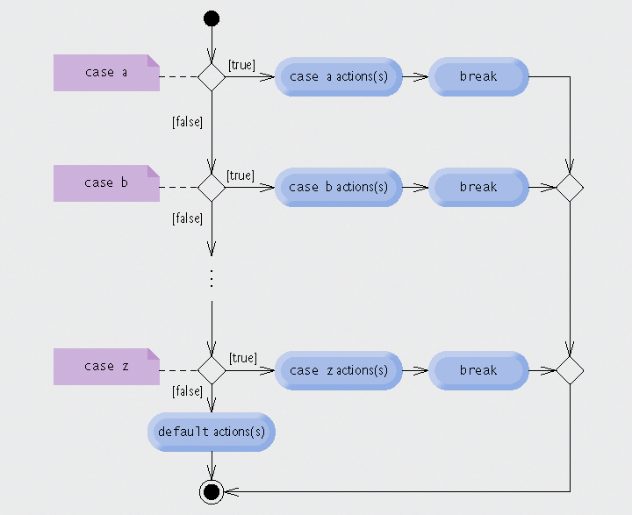
Fig. 5.12 | switch multiple-selection statement UML activity diagram with break statements.

Slide 66
Common Programming Error 5.12
Providing identical case labels in a switch statement is a compilation error. Providing case labels containing different expressions that evaluate to the same value also is a compilation error. For example, placing case 4 + 1: and case 3 + 2: in the same switch statement is a compilation error, because these are both equivalent to case 5:.

Slide 67
5.6 switch Multiple-Selection Statement (Cont.)
Integer data types
  short
    Abbreviation of short int
    Minimum range is -32,768 to 32,767
  long
    Abbreviation of long int
    Minimum range is -2,147,483,648 to 2,147,483,647
  int
    Equivalent to either short or long on most computers
  char
    Can be used to represent small integers

Slide 68
Portability Tip 5.4
Because ints can vary in size between systems, use long integers if you expect to process integers outside the range –32,768 to 32,767 and you would like to run the program on several different computer systems.

Slide 69
Performance Tip 5.3
If memory is at a premium, it might be desirable to use smaller integer sizes.

Slide 70
Performance Tip 5.4
Using smaller integer sizes can result in a slower program if the machine’s instructions for manipulating them are not as efficient as those for the natural-size integers, i.e., integers whose size equals the machine’s word size (e.g., 32 bits on a 32-bit machine, 64 bits on a 64-bit machine). Always test proposed efficiency “upgrades” to be sure they really improve performance.

Slide 71
5.7 break and continue Statements
break/continue statements
  Alter flow of control
break statement
  Causes immediate exit from control structure
  Used in while, for, do…while or switch statements
continue statement
  Skips remaining statements in loop body
    Proceeds to increment and condition test in for loops
    Proceeds to condition test in while/do…while loops
  Then performs next iteration (if not terminating)
  Used in while, for or do…while statements

Slide 72
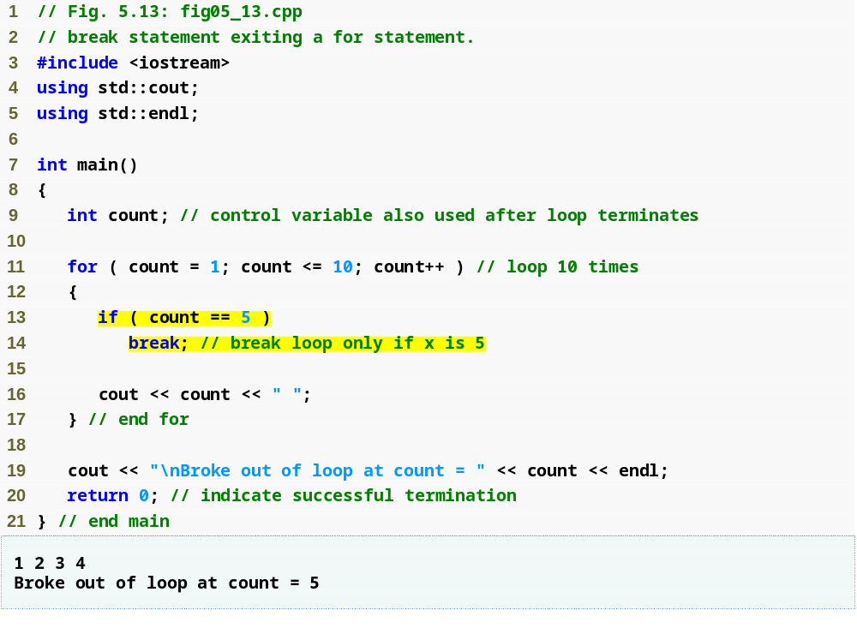
Outline
fig05_13.cpp
(1 of 1)
Loop 10 times
Exit for statement (with a break) when count equals 5

Slide 73
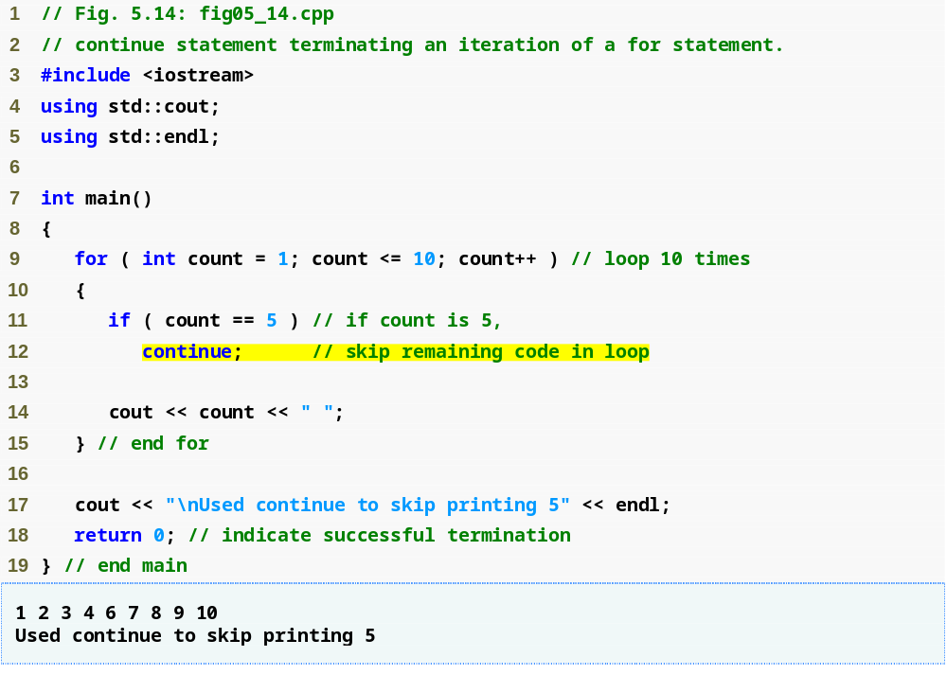
Outline
Loop 10 times
fig05_14.cpp
(1 of 1)
Skip line 14 and proceed to line 9 when count equals 5

Slide 74
Good Programming Practice 5.12
Some programmers feel that break and continue violate structured programming. The effects of these statements can be achieved by structured programming techniques we soon will learn, so these programmers do not use break and continue. Most programmers consider the use of break in switch statements acceptable.

Slide 75
Performance Tip 5.5
The break and continue statements, when used properly, perform faster than do the corresponding structured techniques.

Slide 76
Software Engineering Observation 5.1
There is a tension between achieving quality software engineering and achieving the best-performing software. Often, one of these goals is achieved at the expense of the other. For all but the most performance-intensive situations, apply the following guideline: First, make your code simple and correct; then make it fast and small, but only if necessary.

Slide 77
5.8 Logical Operators
Logical operators
  Allows for more complex conditions
    Combines simple conditions into complex conditions
C++ logical operators
  && (logical AND)
  || (logical OR)
  ! (logical NOT)

Slide 78
5.8 Logical Operators (Cont.)
Logical AND (&&) Operator
  Consider the following if statement
    if ( gender == 1 && age >= 65 )
    seniorFemales++;
  Combined condition is true
    If and only if both simple conditions are true
  Combined condition is false
    If either or both of the simple conditions are false

Slide 79
Common Programming Error 5.13
Although 3 < x < 7 is a mathematically correct condition, it does not evaluate as you might expect in C++. Use ( 3 < x && x < 7 ) to get the proper evaluation in C++.

Slide 80
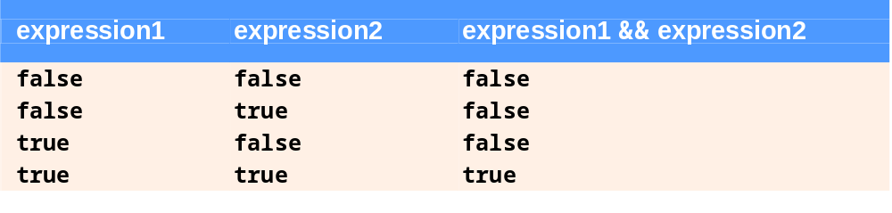
Fig. 5.15 | && (logical AND) operator truth table.

Slide 81
5.8 Logical Operators (Cont.)
Logical OR (||) Operator
  Consider the following if statement
    if ( ( semesterAverage >= 90 ) || ( finalExam >= 90 )
    cout << “Student grade is A” << endl;
  Combined condition is true
    If either or both of the simple conditions are true
  Combined condition is false
    If both of the simple conditions are false

Slide 82
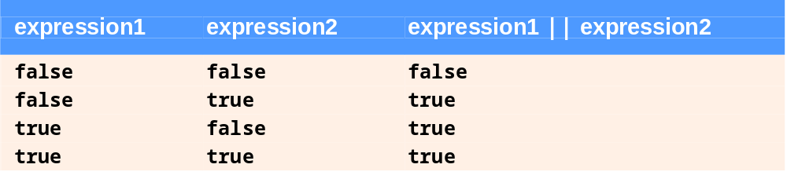
Fig. 5.16 | || (logical OR) operator truth table.

Slide 83
5.8 Logical Operators (Cont.)
Short-Circuit Evaluation of Complex Conditions
  Parts of an expression containing && or || operators are evaluated only until it is known whether the condition is true or false
  Example
    ( gender == 1 ) && ( age >= 65 )
      Stops immediately if gender is not equal to 1
        Since the left-side is false, the entire expression must be false

Slide 84
Performance Tip 5.6
In expressions using operator &&, if the separate conditions are independent of one another, make the condition most likely to be false the leftmost condition. In expressions using operator ||, make the condition most likely to be true the leftmost condition. This use of short-circuit evaluation can reduce a program’s execution time.

Slide 85
5.8 Logical Operators (Cont.)
Logical Negation (!) Operator
  Unary operator
  Returns true when its operand is false, and vice versa
  Example
    if ( !( grade == sentinelValue ) )
    cout << "The next grade is " << grade << endl;
    is equivalent to:
    if ( grade != sentinelValue )
    cout << "The next grade is " << grade << endl;
Stream manipulator boolalpha
  Display bool expressions in words, “true” or “false”

Slide 86
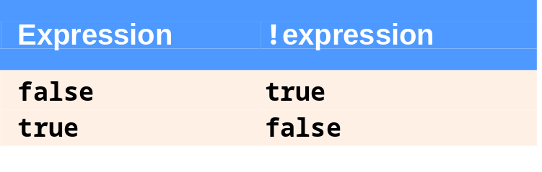
Fig. 5.17 | ! (logical negation) operator truth table.

Slide 87
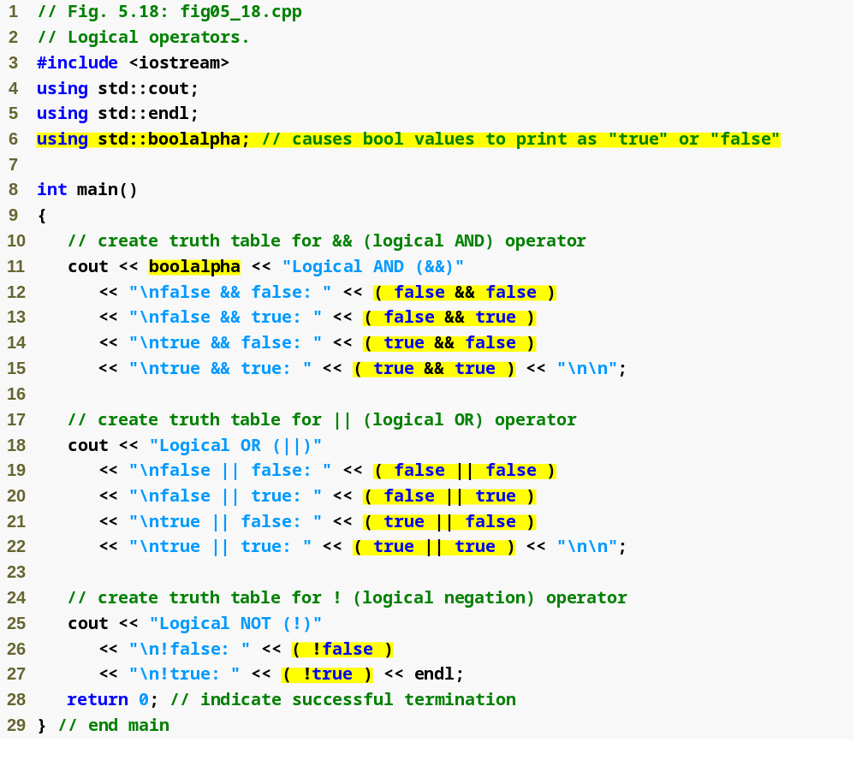
Stream manipulator boolalpha causes bool values to display as the words “true” or “false”
Outline
fig05_18.cpp
(1 of 2)
Use boolalpha stream manipulator
Output logical AND truth table
Output logical OR truth table
Output logical NOT truth table

Slide 88
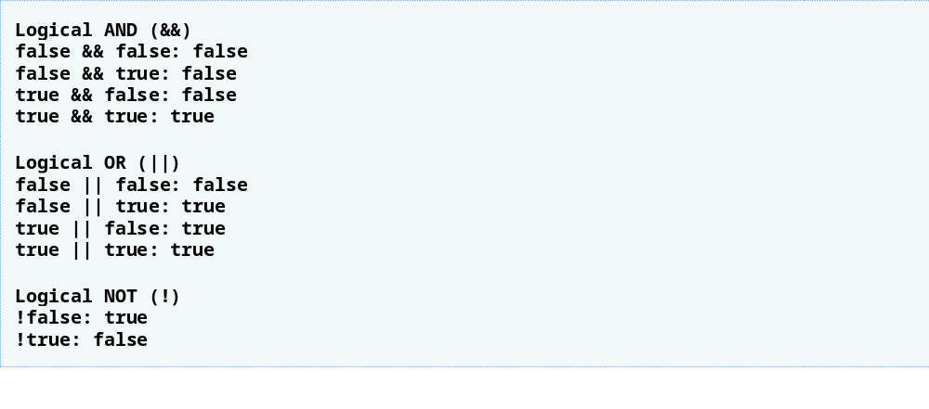
Outline
fig05_18.cpp
(2 of 2)

Slide 89
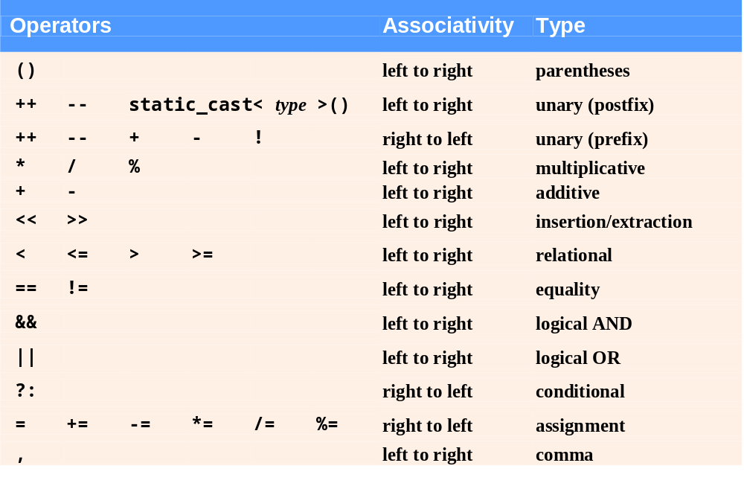
Fig. 5.19 | Operator precedence and associativity.

Slide 90
5.9 Confusing Equality (==) and Assignment (=) Operators
Accidentally swapping the operators == (equality) and = (assignment)
  Common error
    Assignment statements produce a value (the value to be assigned)
    Expressions that have a value can be used for decision
      Zero = false, nonzero = true
  Does not typically cause syntax errors
    Some compilers issue a warning when = is used in a context normally expected for ==

Slide 91
5.9 Confusing Equality (==) and Assignment (=) Operators (Cont.)
Example
    if ( payCode == 4 )
    cout << "You get a bonus!" << endl;
  If paycode is 4, bonus is given
If == is replaced with =
    if ( payCode = 4 )
    cout << "You get a bonus!" << endl;
  paycode is set to 4 (no matter what it was before)
  Condition is true (since 4 is non-zero)
    Bonus is incorrectly given in every case

Slide 92
Common Programming Error 5.14
Using operator == for assignment and using operator = for equality are logic errors.

Slide 93
Error-Prevention Tip 5.3
Programmers normally write conditions such as
x == 7 with the variable name on the left and the constant on the right. By reversing these so that the constant is on the left and the variable name is on the right, as in 7 == x, the programmer who accidentally replaces the == operator with = will be protected by the compiler. The compiler treats this as a compilation error, because you can’t change the value of a constant. This will prevent the potential devastation of a runtime logic error.

Slide 94
5.9 Confusing Equality (==) and Assignment (=) Operators (Cont.)
Lvalues
  Expressions that can appear on left side of assignment
  Can be changed (i.e., variables)
    x = 4;
Rvalues
  Only appear on right side of equation
  Constants, such as numbers (i.e. cannot write 4 = x;)
Lvalues can be used as rvalues, but not vice versa

Slide 95
Error-Prevention Tip 5.4
Use your text editor to search for all occurrences of = in your program and check that you have the correct assignment operator or logical operator in each place.

Slide 96
5.10 Structured Programming Summary
Structured programming
  Produces programs that are easier to understand, test, debug and modify
Rules for structured programming
  Only use single-entry/single-exit control structures
  Rules (Fig. 5.21)
    Rule 2 is the stacking rule
    Rule 3 is the nesting rule

Slide 97
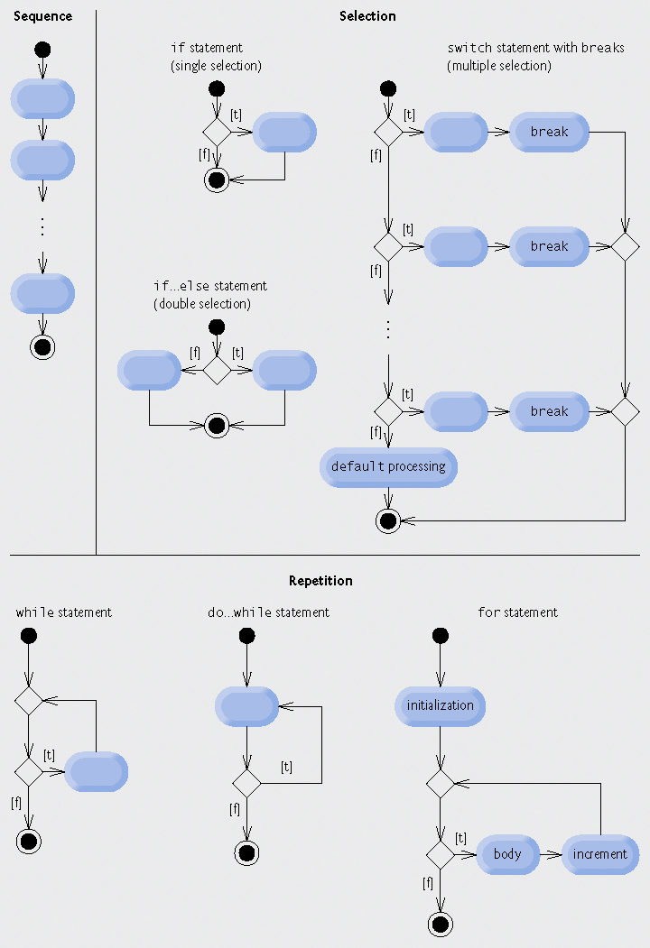
Fig. 5.20 | C++’s single-entry/single-exit sequence, selection and repetition statements.

Slide 98
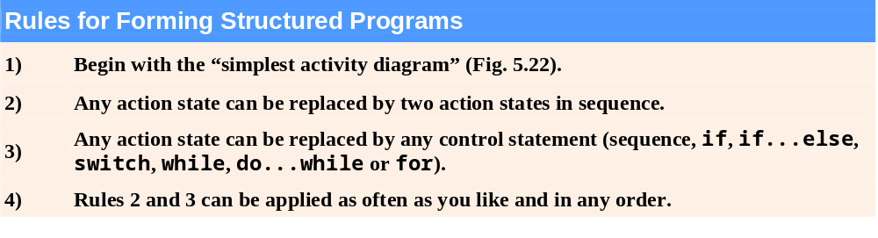
Fig. 5.21 | Rules for forming structured programs.

Slide 99

Fig. 5.22 | Simplest activity diagram.

Slide 100
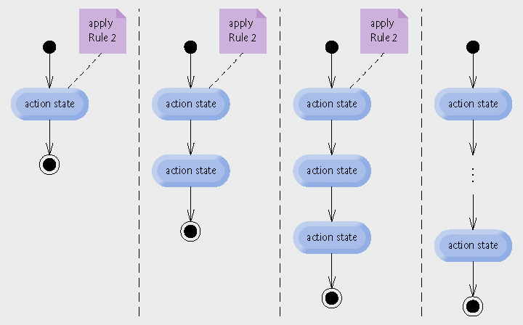
Fig. 5.23 | Repeatedly applying Rule 2 of Fig. 5.21 to the simplest activity diagram.

Slide 101
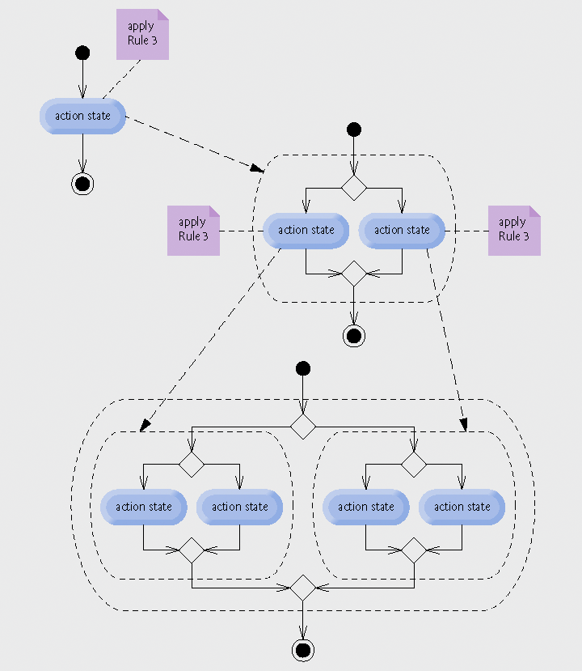
Fig. 5.24 | Applying Rule 3 of Fig. 5.21 to the simplest activity diagram several times.

Slide 102
5.10 Structured Programming Summary (Cont.)
Sequence structure
  “built-in” to C++
Selection structure
  if, if…else and switch
Repetition structure
  while, do…while and for

Slide 103
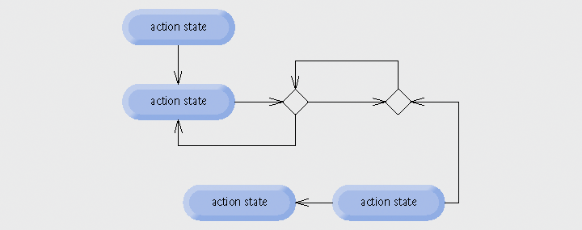
Fig. 5.25 | Activity diagram with illegal syntax.

Slide 104
5.11 (Optional) Software Engineering Case Study: Identifying Object’s State and Activities in the ATM System
State Machine Diagrams
  Commonly called state diagrams
  Model several states of an object
    Show under what circumstances the object changes state
    Focus on system behavior
  UML representation
    Initial state
      Solid circle
    State
      Rounded rectangle
    Transitions
      Arrows with stick arrowheads

Slide 105

Fig. 5.26 | State diagram for the ATM object.

Slide 106
Software Engineering Observation 5.2
Software designers do not generally create state diagrams showing every possible state and state transition for all attributes—there are simply too many of them. State diagrams typically show only the most important or complex states and state transitions.

Slide 107
5.11 (Optional) Software Engineering Case Study : Identifying Object’s State and Activities in the ATM System (Cont.)
Activity Diagrams
  Focus on system behavior
  Model an object’s workflow during program execution
    Actions the object will perform and in what order
  UML representation
    Initial state
      Solid circle
    Action state
      Rectangle with outward-curving sides
    Action order
      Arrow with a stick arrowhead
    Final state
      Solid circle enclosed in an open circle

Slide 108
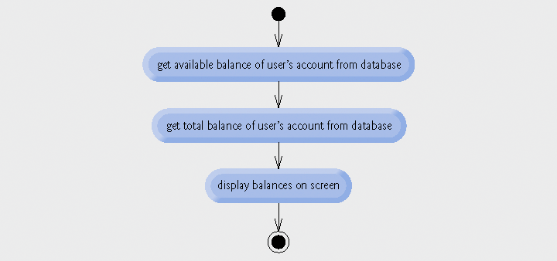
Fig. 5.27 | Activity diagram for a BalanceInquiry transaction.

Slide 109
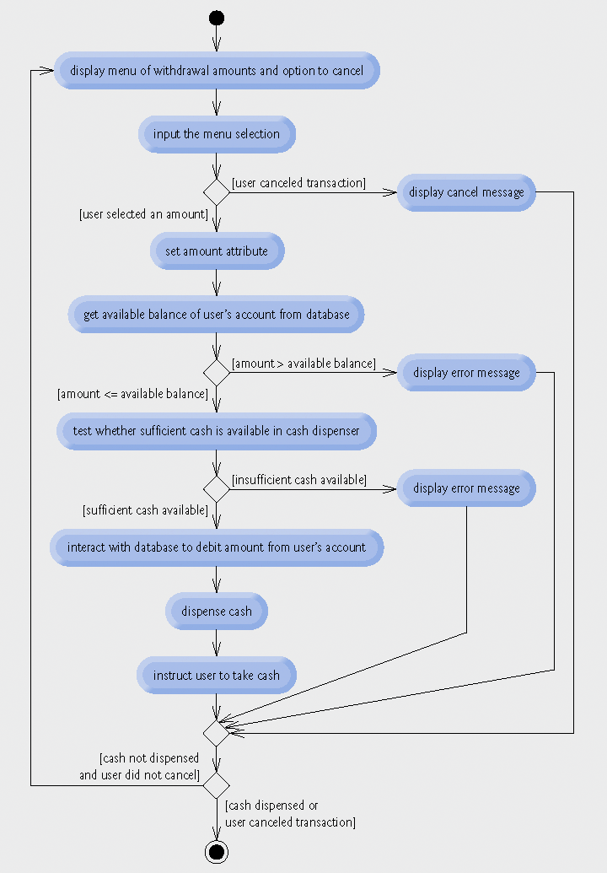
Fig. 5.28 | Activity diagram for a Withdrawal transaction.

Slide 110
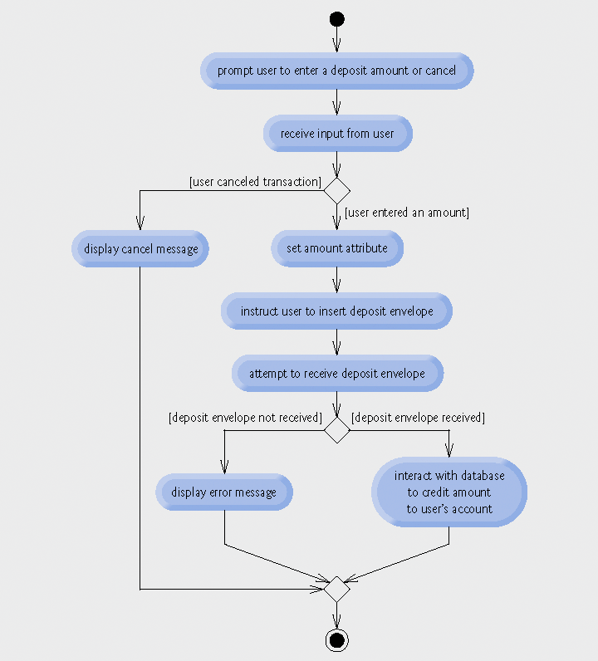
Fig. 5.29 | Activity diagram for a Deposit transaction.

